Slide 1
RUBIK’S CUBE
S SREENIVASA SHENOY (4CB19CS087)
P PADMAPRASAD SHENOY (4CB19CS064)

Slide 2
AGENDA
This project illustrates the use of various OpenGL features such as keyboard interaction, mouse interaction and Menus using continuous translation.
This project was developed on the basis of a popular game on most Sony Ericsson mobiles – Puzzle Slider.
Provides idea to convert a normal 2 Dimensional game into a graphical 3 Dimensional game.
Both Keyboard and Mouse Control for Users is added to this Project.

Slide 3
INTRODUCTION
In our package we are clearly going to demonstrate the working of “Rubik’s Cube Game “. The project improvised on this basic idea to convert a normal 2 Dimensional game into a graphical 3 Dimensional game. The original game is a 2 Dimensional game that involves swapping of any 2 tiles and arranging the tiles in the correct sequence. We modified this idea to include a blank position. This now increases level of difficulty as only the tiles adjacent to the blank position can now be translated, unlike the Puzzle Slider game.

Slide 4
HARDWARE REQUIREMENTS
The physical components required are:
Processor - Pentium Pro
Memory - 128MB RAM
40GB Hard Disk Drive
SOFTWARE REQUIREMENTS
The software used in building this program are:
Operating system – WINDOWS
Tools : Codeblocks
Graphics Library – glut.h
OpenGL 2.0

Slide 5
ALGORITHM
STEP 1: Define vertices for 27 cubes which are used to compose one whole cube known as “Rubiks cube”.
STEP 2: Define colors for each cube of the Rubiks cube to distinguish one cube from the other and as well as color for the speed meter, which is used to control the speed of rotation.
Output( ) function:
STEP 3: This function is used to display the message using the Commands glutBitmapCharacter( ) and glRasterpos*( ).
Polygon( ) function:
STEP 4: Draw a polygon via list of vertices with the line of 3 pixels wide.
Colorcube( ) function:
STEP 5: Map vertices to faces. Hence the use of colorcube function has done 27 times with different prefixes for all the 27 cubes amongst which one with no color, 6 with one color, 12 with two colors and 8 with three colors on it.
Speedmeter( ) function:
STEP 6: This function is used to define vertices for a speedmeter, which is used to control the speed of rotation.

Slide 6
Display( ) function:
STEP 7: Clear the frame buffers and the z-buffer.
STEP 8: Invoke the function speedmeter and output.
STEP 9: Using the variables rotation and inverse the rotation for the faces are defined, where if rotation is one and the inverse flag is zero then the top face of the cube will be rotated in the clockwise direction and incase if rotation is one and also is the inverse flag then the top face of the cube will be rotated in the anti-clockwise direction.
STEP 10: The same procedure that has been specified in the step 9 is adopted with different values for the rotation, such as rotation with the value two is implemented for right three for front, four for left, five for back and six for bottom rotations respectively with the implementation of inverse variable being same.
STEP 11: Invoke the output function and swap the buffers.
Transpose( ) function:
STEP 12: This function is used to define the transpose for all the six faces.
Topc( ) function:
STEP 13: This function is used to assign the values when the operation is rotation of the top face.
Frontc( ) function:
STEP 14: This function is used to assign the values when the operation is rotation of the front face.

Slide 7
Rightc( ) function:
STEP 15: This function is used to assign the values when the operation is rotation of the right face.
Leftc( ) function:
STEP 16: This function is used to assign the values when the operation is rotation of the left face.
Backc( ) function:
STEP 17: This function is used to assign the values when the operation is rotation of the back face.
Bottomc( ) function:
STEP 18: This function is used to assign the values when the operation is rotation of the bottom face.
Spincube( ) function:
STEP 19: This is function is an idle callback which rotates the cube accordingly, if rotation is one and inverse is zero then rotate the top face of the cube by 90 degrees in the clockwise direction and if inverse is one then rotate the same face by 90 degree in the anti-clockwise direction.
STEP 20: The same procedure is implemented for the other faces of the cube with different rotation values.
STEP 21: The cube is redisplayed after the rotation.

Slide 8
Motion( ) function:
STEP 22: This is used to rotate the cube about the selected axis.
Mouse( ) function:
STEP 23: Mouse callback function. This allows user to give input through mouse buttons.
Keyboard( ) function:
STEP 24: use the keys ‘a’,’s’,’d’,’f’,’g’,’h’ to rotate the faces of the accordingly in the clockwise direction and the keys ‘q’,’w’,’e’,’r’,’t’,’y’ to rotate in the anti-clockwise direction.
STEP 25: use the keys ‘1’,’2’,’4’,’5’,’6’,’8’,’9’ are used to move the viewer along the axis.
STEP 26: use the keys ‘m’ and ‘n’ to alter the value of the rotation meter which controls the speed of the rotation.
STEP 27: use the key ‘o’ for the automatic solving of the cube.
Myreshape( ) function:
STEP 28: Define a viewport and set the matrix to projection and modelview matrices.
Mymenu( ) function:
STEP 29: Define the actions corresponding to each entry in the menu.
Main( ) function:
STEP 30: Both double and z-buffer is enabled. Invoke the start function.
STEP 31: Add entries to the menu and link the menu to the right mouse button.
STEP 32: Stop.

Slide 9
Built-in Functions used: (Part 1)
glutInit(&argc, argv);
glutInitDisplayMode();
glutInitWindowSize();
glutCreateWindow();
glutReshapeFunc();
glutIdleFunc();
glutMouseFunc();
glutMotionFunc();
glutCreateMenu();

Slide 10
Built-in Functions used: (Part 2)
glutAddMenuEntry();
glutAttachMenu(GLUT_RIGHT_BUTTON);
glutKeyboardFunc(keyboard);
glutDisplayFunc(display);
glutMainLoop();
glClear();
glLoadIdentity();
speedmeter();
glColor3fv();
glPushMatrix();
glRotatef();

Slide 11
User-defined Functions used:
void polygon();
void colorcube();
void speedmeter();
void display();
void transpose();
void topc()
void frontc()
void rightc();
void leftc();
void bottomc();
void backc();
void spincube();
void spincube();
void mouse();
void keyboard();
void myreshape();
void mymenu();

Slide 12
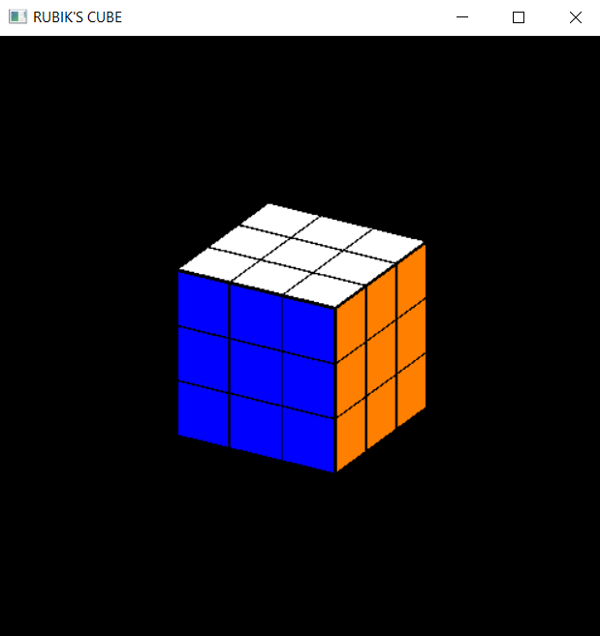
DISPLAY

Slide 13
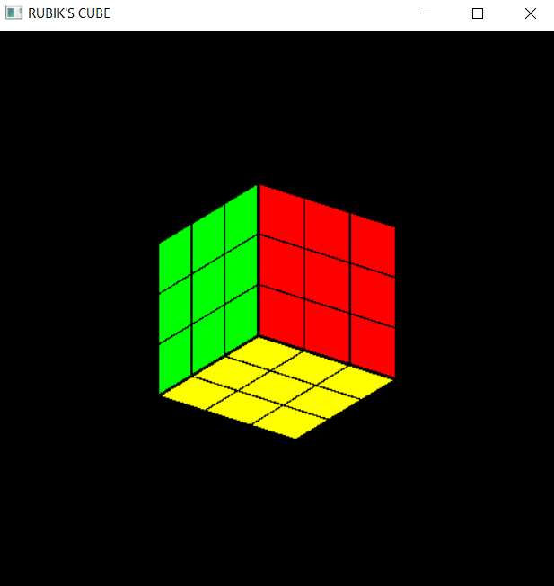
OTHER SIDE

Slide 14
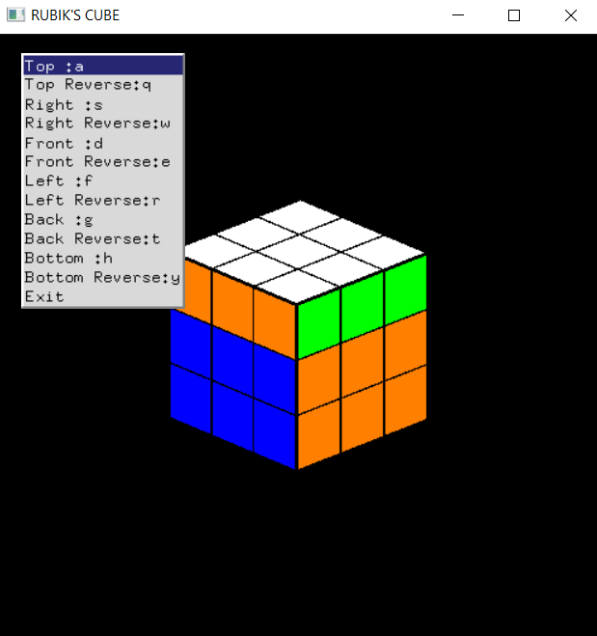
TOP ROTATE (CLOCKWISE)

Slide 15
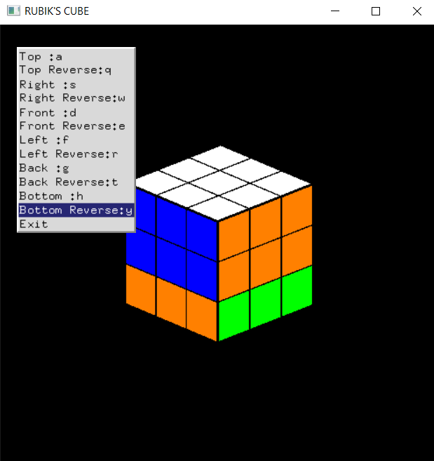
BOTTOM ROTATE (ANTI-CLOCKWISE)

Slide 16
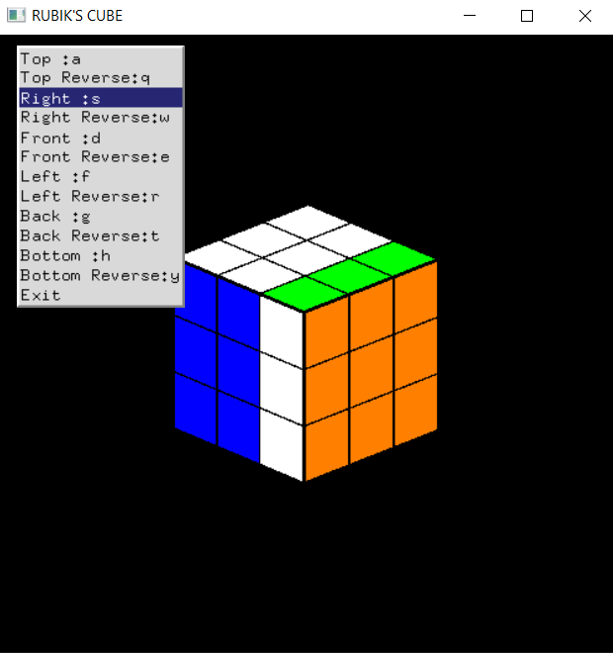
RIGHT ROTATE (CLOCKWISE)

Slide 17
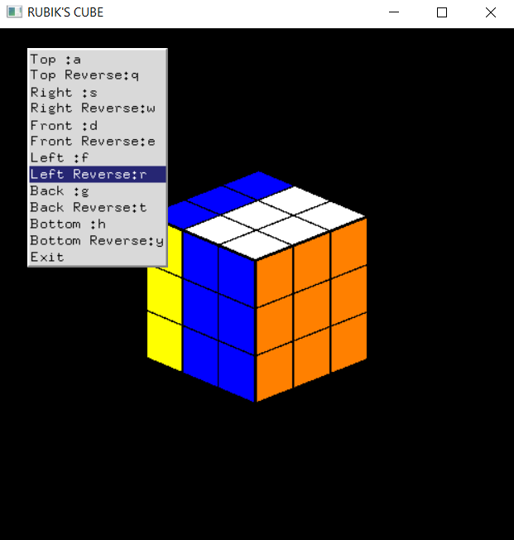
LEFT ROTATE (ANTI-CLOCKWISE)

Slide 18
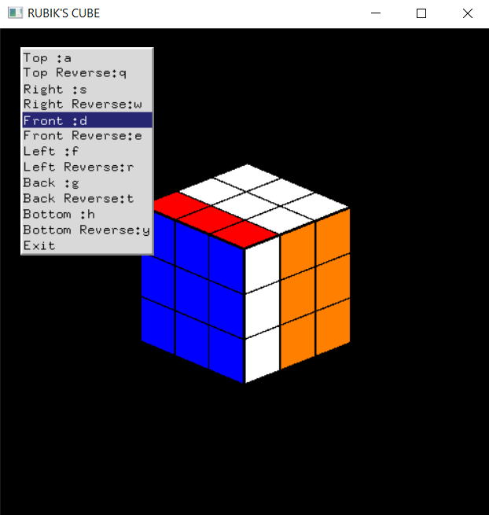
FRONT ROTATE (CLOCKWISE)

Slide 19
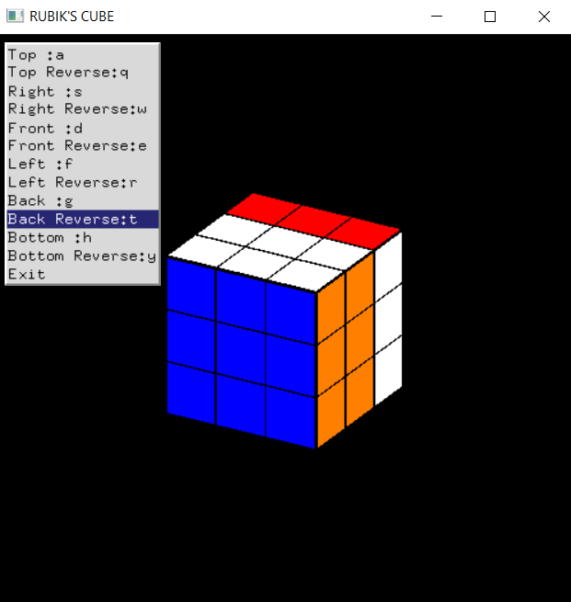
BACK ROTATE (ANTI-CLOCKWISE)

Slide 20
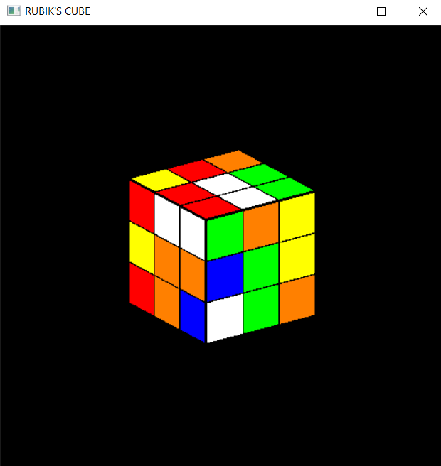
READY TO SOLVE!!

Slide 21
CONCLUSION & FUTURE IDEAS
We successfully implemented the Rubik’s Cube game with tiles and frame.
FUTURE IDEAS
The extra features can be added including Player’s name and a clock that starts at the beginning of the game.
To make the high score list permanent, a text file is running at the back end.
Adding cheat codes like most commercial games, so that the player can enter them and the fully solved puzzle is displayed. This can also be used to view the effects when a player makes it to the Hall of Fame.
Give the option of allowing the user to put any image of his choice onto the tiles. This again involves Texture mapping and image processing.
Implementing different levels with increasing levels of difficulty.

Slide 22
THANK YOU

